Slide 1
Data Visualization using EXCEL-project

Slide 2
CASELET
Motor gateways is a global bike dealer company operating in multiple countries. The configuration of the company has been rise. This is concerning the management at a time when the economy is challenging. The management has called a high level meeting consisting of the group CEO, Business partner, management team and BA.
The management expects you to summarise key actionable insights to rise the profile margin according to you in a dashboards consisting of 4 charts.

Slide 3
Key CONCERNS
What type of age group has highest and lowest purchase ?
Which is the total sale of particular region ?
What is the average income who buy and who did not buy bike ?
What is the commute distance who purchase bike ?

Slide 4
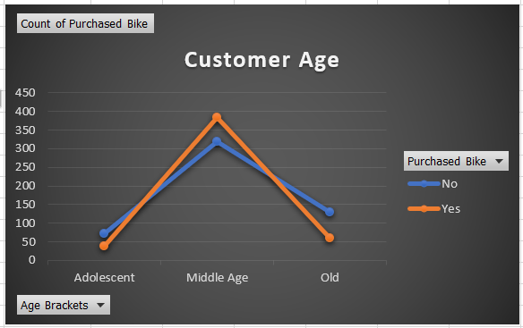
What type of age group has highest and lowest purchase ?

Slide 5
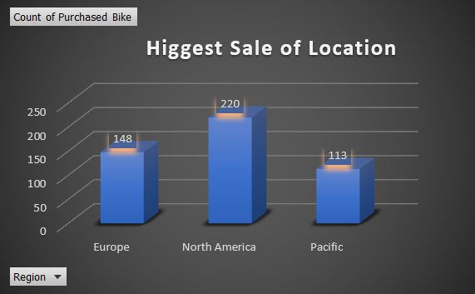
Which is the total sale of particular region ?

Slide 6
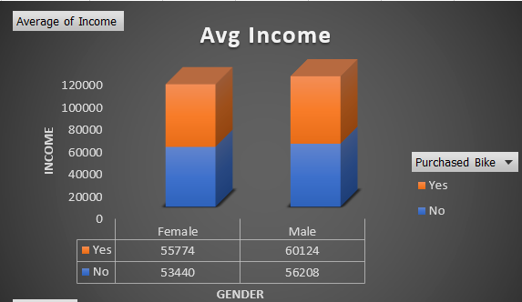
What is the average income who buy and who did not buy bike ?

Slide 7
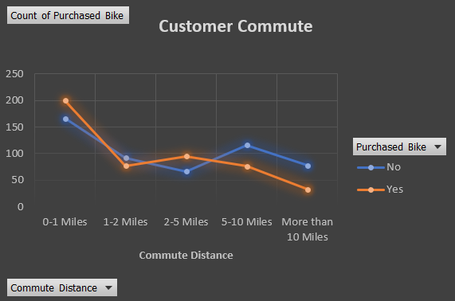
What is the commute distance who purchase bike ?

Slide 8

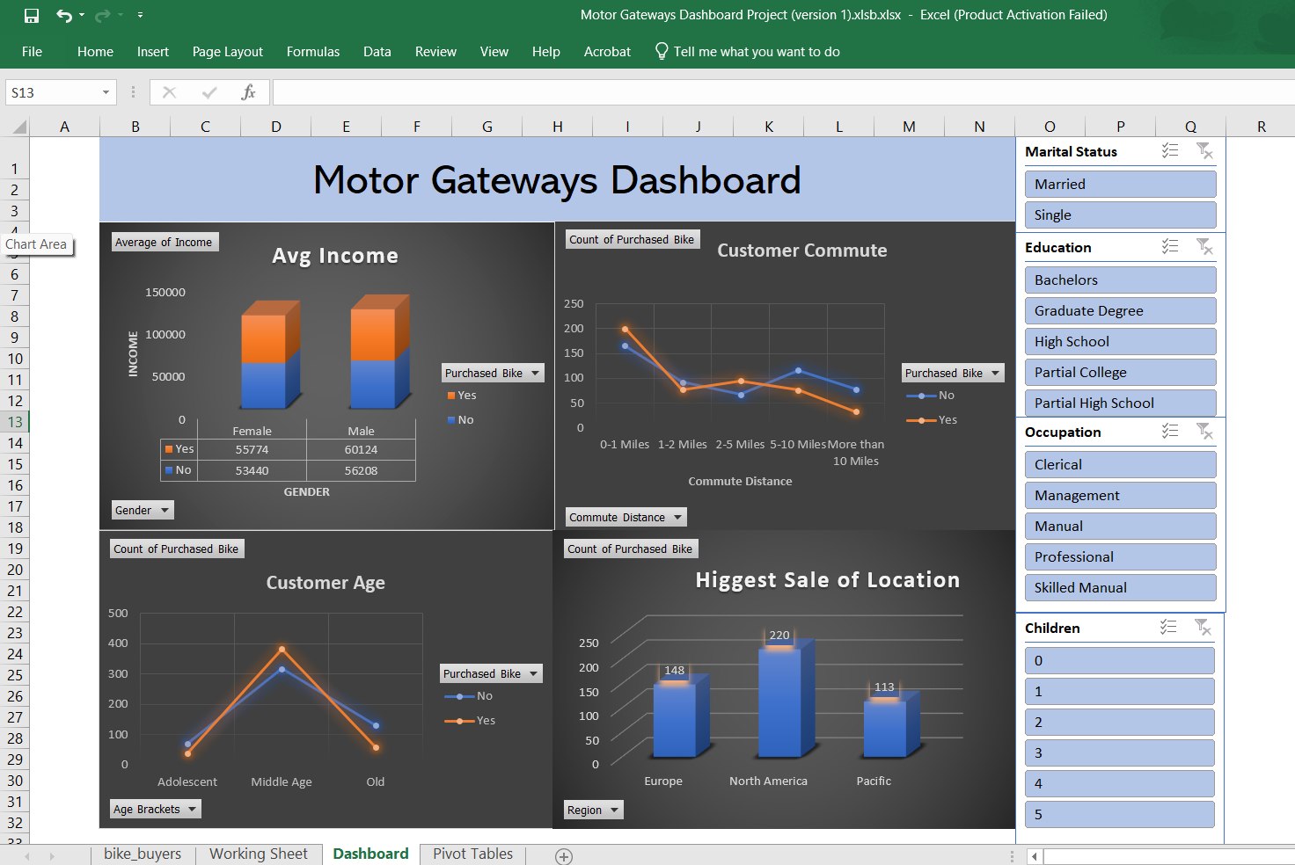

INTERACTIVE DASHBOARD

Slide 9
THANK YOU
REFERENCE: https://youtu.be/opJgMj1IUrc

